Slide 1

group 8
Cryptocurrency Price Analysis and Trend Prediction
A . Hyma Hithyshini
A . Bhargavi
Praneetha . M
M . Bhavya

Slide 2
Introduction to Cryptocurrency
Cryptocurrency is a digital or virtual currency that uses cryptography for security. It operates independently of a central authority and is based on blockchain technology. The rise of cryptocurrencies such as Bitcoin, Ethereum, and many others has transformed the financial landscape, creating new investment opportunities and challenges.

Slide 3
Importance of Price Analysis
Price analysis is crucial in the cryptocurrency market due to its volatility and rapid changes. Understanding price trends helps investors:
- Make informed decisions.
- Minimize risks associated with trading.
- Identify profitable investment opportunities.
- Gain insights into market sentiment and behavior.

Slide 4
Objective
The primary objective of this project is to analyze cryptocurrency price trends and make predictions about future price movements.
- Understand historical price movements.
- Identify key trends and patterns.
- Develop a predictive model for future price forecasting.
- Provide insights for potential investors and traders.

Slide 5

Datsets
For this analysis, we will use a dataset from Kaggle comprising historical price data for various cryptocurrencies. The dataset will include these types of Cryptos :
XPR
LTC
ETH
BTC

Slide 6
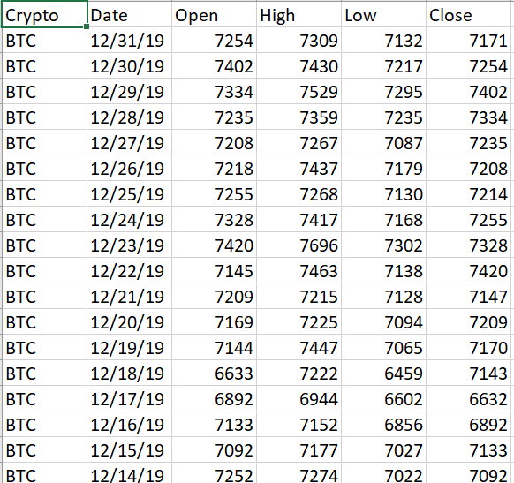
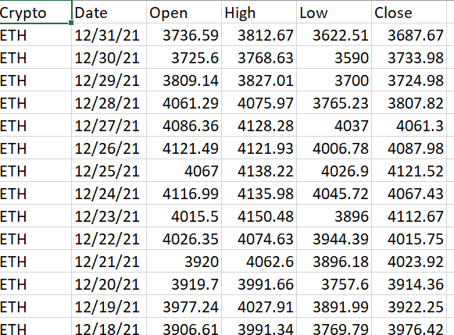
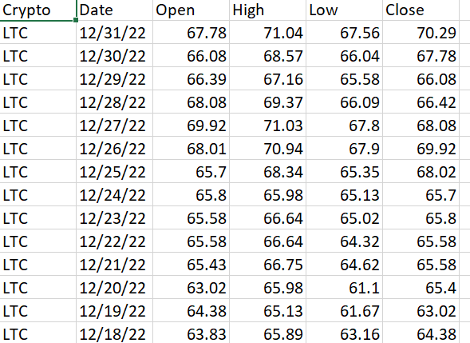
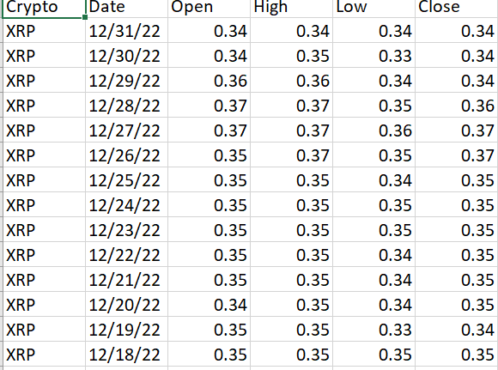

Slide 7
Libraries
We will be using the following libraries for data analysis and visualization
Pandas: For data manipulation and analysis.
NumPy: For numerical operations and calculations.
Matplotlib: For data visualization.
Seaborn: For statistical data visualization.
Scikit-Learn: For implementing predictive models.
TensorFlow/Keras: For deep learning.
Statsmodels: For time series analysis.

Slide 8
Methodology Overview
Data Preprocessing
Deep Learning Models
Time Series Forecasting
Cleaning and preparing the dataset for analysis.
RNNs: LSTM, GRU.
Hybrid Models
ARIMA, SARIMA, Facebook Prophet.
Machine Learning Models
Sentiment Analysis
Reinforcement Learning
Tree-Based: Random Forest, Decision Tree Regressor.
SVR: For volatile price movements.
NLP: VADER, BERT/GPT for news sentiment.
Alternative Data: Google Trends & Social Media.
DQN, PPO for market
prediction.

Slide 9
Outcome of the Cryptocurrency Price Prediction Model:
Accurate Price Forecasts: Predicts short- and long-term prices, with LSTM capturing trends
and XGBoost improving precision.
Market Trend Analysis: Identifies bullish and bearish signals, aiding buy/sell decisions.
Reduced Prediction Errors: Optimized with MAE and RMSE for better accuracy.
Real-Time Sentiment Impact: Analyzes social media and news to predict market movements.
Risk & Volatility Assessment: Detects high volatility and alerts traders to risks.

Slide 10
Thank You

